Slide 1
Document Object Model

Slide 2
Document Object Model
DOM Tree
Types of DOM Nodes for HTML
DOM Node Properties
DOM Node Methods
Checking for parent and child nodes
Element Collection
Finding specific elements
Creating Nodes
Appending and Inserting Nodes
Copying Nodes
Deleting or Replacing Nodes
Methods for manipulating TextNode
Attribute Manipulation
DOM and CSS
Additional Properties

Slide 3
Document Object Model
An object model defines the interface to the various aspects of the browser and the document that can be manipulated by JavaScript.
The DOM provides an application programming interface (API) that exposes the entirety of a Web page (including tags, attributes, style, and content) to a programming language like JavaScript.

Slide 4
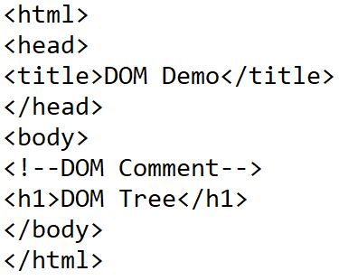
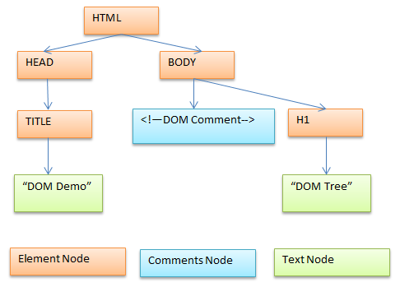
DOM Tree

Slide 5
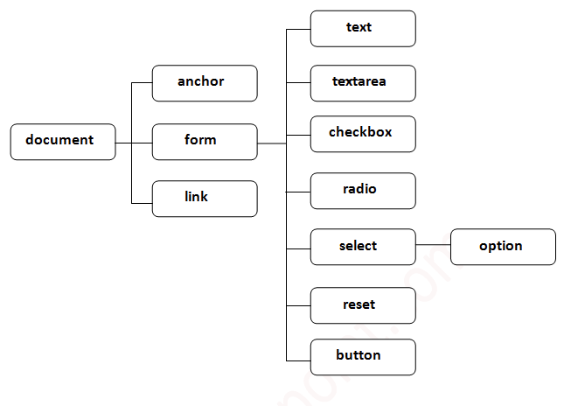

Slide 6
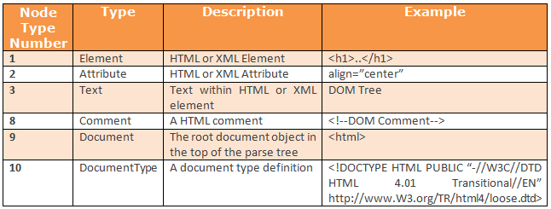
Types of DOM Nodes for HTML

Slide 7
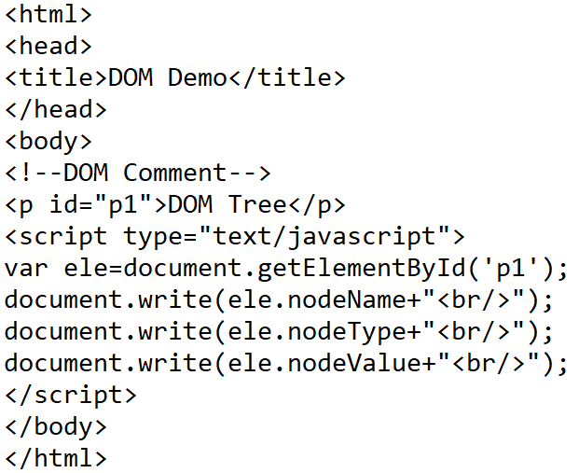

Example of DOM Element Node

Slide 8
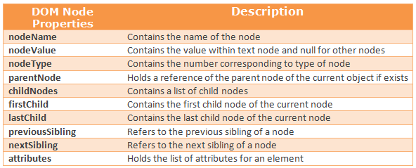
DOM Node Properties

Slide 9
Node Type
Returned integer Node type Constant
1 ELEMENT_NODE
2 ATTRIBUTE_NODE
3 TEXT_NODE
4 CDATA_SECTION_NODE
5 ENTITY_REFERENCE_NODE
6 ENTITY_NODE
7 PROCESSING_INSTRUCTION_NODE
8 COMMENT_NODE
9 DOCUMENT_NODE
10 DOCUMENT_TYPE_NODE
11 DOCUMENT_FRAGMENT_NODE
12` NOTATION_NODE

Slide 10
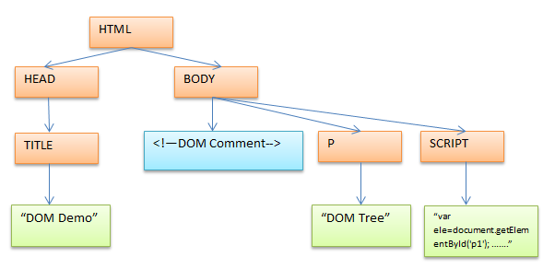
DOM Node Properties Demo

Slide 11
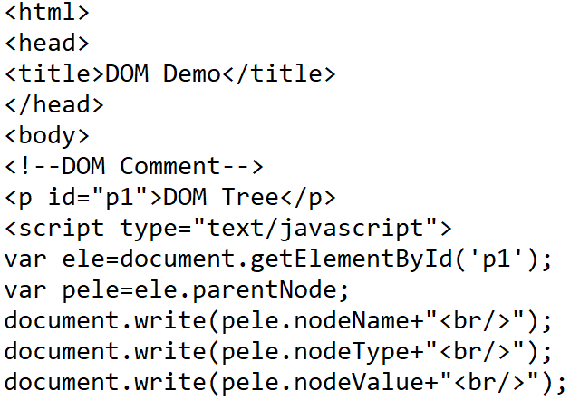

DOM Node Properties Demo

Slide 12
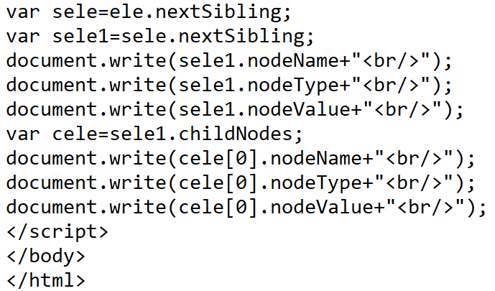
DOM Node Properties Demo

Slide 13
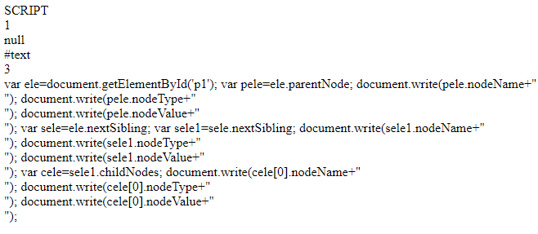
DOM Node Properties Demo

Slide 14
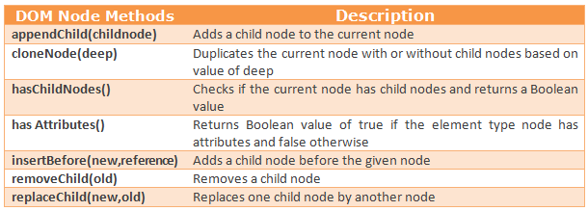
DOM Node Methods

Slide 15
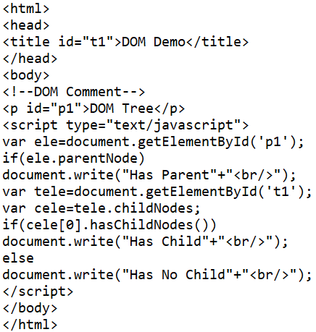

Checking for parent node and child node

Slide 16
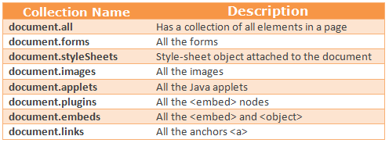
Element Collections

Slide 17
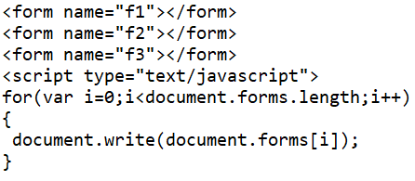

Element Collections

Slide 18
Finding Specific Elements
getElementsByName() –
Static function
Older HTML documents use name instead of id.
Multiple tags can have the same name. Ex. <img> and <form> can have the same name.
This method return a list of nodes rather than a single node.
name is not unique as id.

Slide 19
Finding Specific Elements
varList = document.getElementsByName('myp');
for (var i = 0; i < varList.length; i++)
alert(varList.item(i).nodeName);
_________________________________
varList = document.getElementsByName('myp);
for (var i = 0; i <varList.length; i++)
alert(varList[i].nodeName);

Slide 20
Finding Specific Elements
getElementsByTagName() –
The method returns a list of all the tags in the document that are of the type passed as the parameter.
varallp = document.getElementsByTagName('p');
It is possible to find elements within other elements.
For example, you might want to find a particular paragraph and then find the <em> tags within:
para1 = document.getElementById('p1');
emele = para1.getElementsByTagName('em');

Slide 21
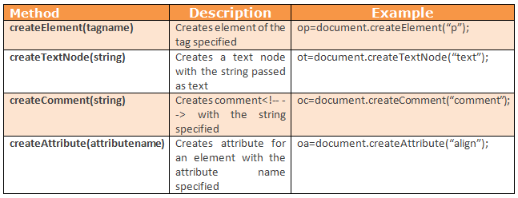
Creating Nodes – document methods

Slide 22
Creating a node
//New heading node created
var newelementnode = document.createElement(“h1”);
//New text node for the heading created
var newtextnode = document.createTextNode(“New text added”);
//The two objects needs to be linked
appendChild() – appends a child node to the node referencing it.
insertBefore() – inserts the new child before the referenced child
newelementnode.appendChild(newtextnode);
parentNode.insertBefore(newNode, existingNode);

Slide 23
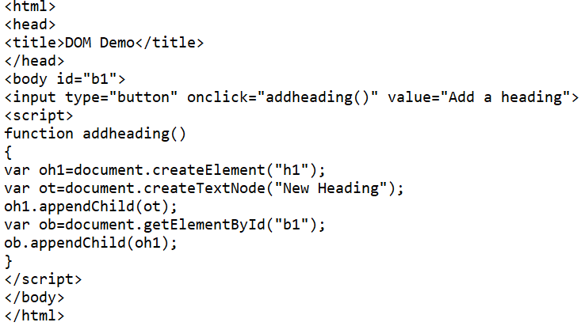

appendChild()

Slide 24
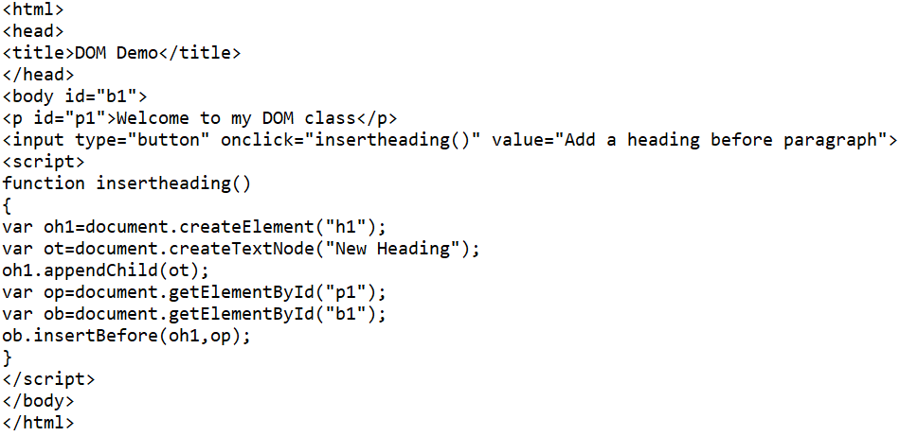
insertBefore()

Slide 25

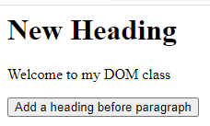
insertBefore()

Slide 26
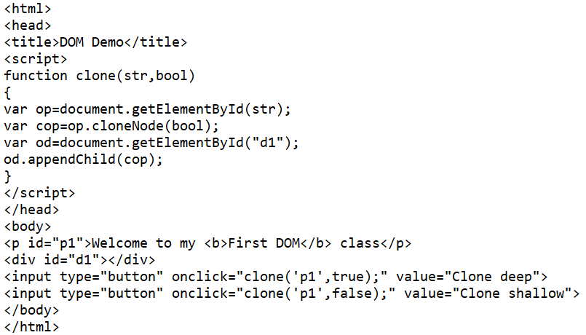

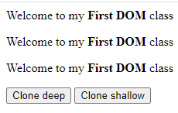
Copying Nodes – cloneNode()

Slide 27
Deleting and Replacing nodes
//deleting nodes
currentobject.removeChild(currentobject.lastChild);
//Replacing nodes
parentNode.replaceChild(newChild, oldChild);

Slide 28
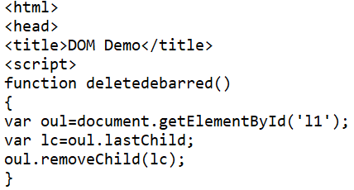
Deleting and Replacing Node

Slide 29
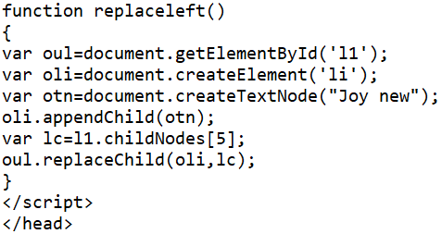
Deleting and Replacing Node

Slide 30
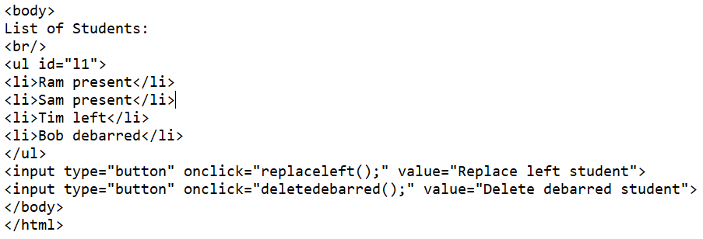
Deleting and Replacing Node

Slide 31
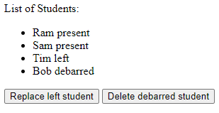
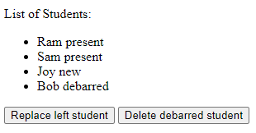
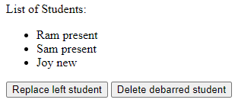
Deleting and Replacing Node

Slide 32
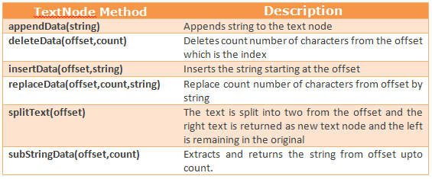
Methods to Manipulate TextNodes

Slide 33
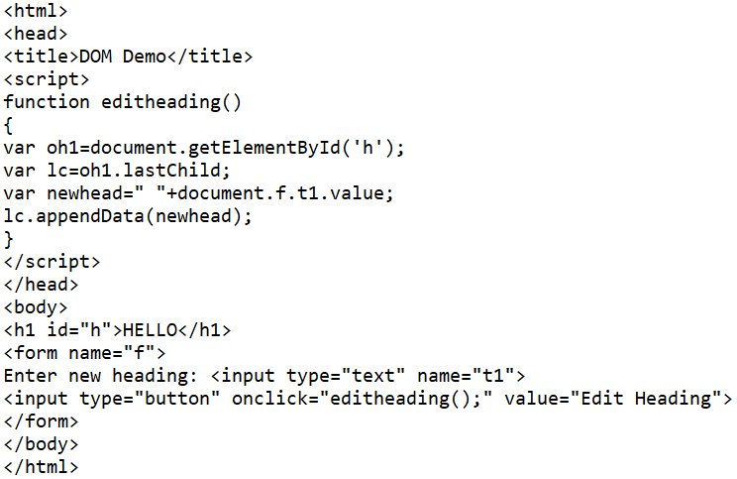
appendData()

Slide 34


appendData()

Slide 35
Attribute Manipulation
getAttribute(name)
setAttribute(attributename, attributevalue)
removeAttribute(attributeName)
hasAttributes()

Slide 36
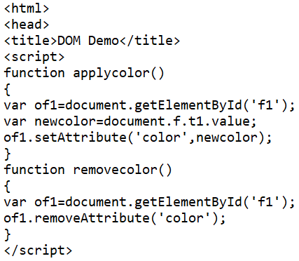
Attribute Manipulation

Slide 37
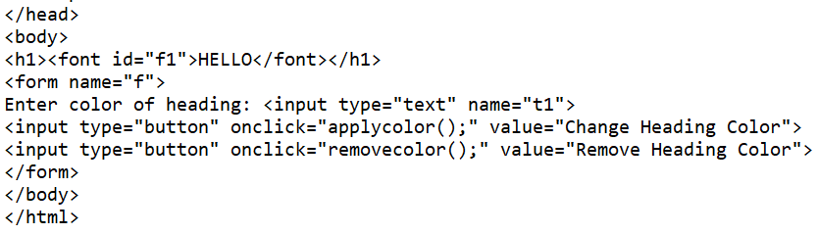
Attribute Manipulation

Slide 38



Attribute Manipulation

Slide 39
DOM and CSS
DOM supports manipulation of CSS values.
For CSS property DOM has a corresponding DOM property.

Slide 40
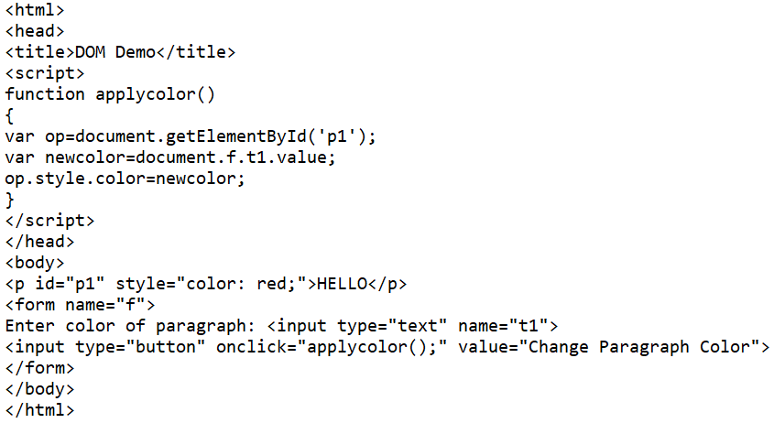
DOM and CSS

Slide 41


DOM and CSS

Slide 42
Additional Properties
innerHTML - Holds a string representing the HTML contained by an element.
innerText – Similar to innerHTML. But returns only as text. This text cannot be rendered on the screen.
outerHTML - To get the source of an element at runtime and to replace the source code of an element with HTML formatted text.
outerText – Similar to outerHTML but replaced at runtime as plain text.

Slide 43
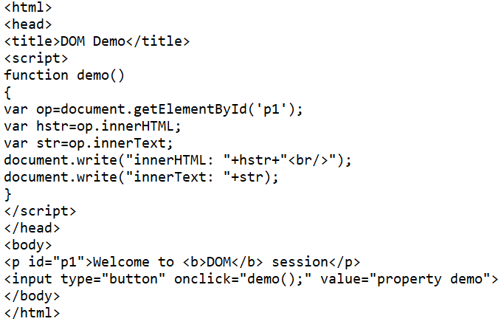
innerHTML, innerText

Slide 44


innerHTML, innerText

Slide 45
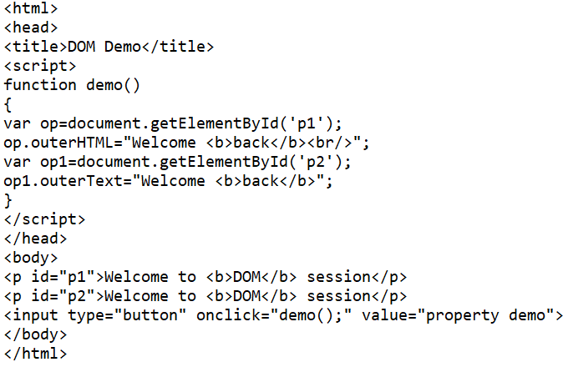
outerHTML, outerText

Slide 46
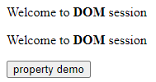

outerHTML, outerText

Slide 47
REFERENCES
Alexei White, JavaScript Programmer’s Reference, Wrox, ISBN:978-81-265-2363-4
Thomas Powell, Fritz Schneider, The Complete Reference – JavaScript Second Edition, TATA McGraw Hill Edition, ISBN-10: 0-07-059027-4

